Slide 1
Clustering

Slide 2
Clustering Problem
There is no class to be predicted rather divide instances into natural groups
Given a training set {x₁, . . . , x_{m}}, but no labels {y₁, …, y_{m}} are given, want to group the data into cohesive clusters.
  Unsupervised learning
  Group data according to similarity

Slide 3
Distance Metric
Typically use a distance metric to judge similarity
A distance metric satisfy
  d(x, y) = 0 iff x = y
  d(x, y) = d(y, x)
    Some applications use asymmetric distances
  d(x, y) + d(y, z) > d(x, z)
Non-real value metrics
  E.g. string edit distance

Slide 4
Clustering Types
Flat clustering
  Group instances into k clusters directly
  E.g. EM, k-means
Hierarchical clustering
  Try to build a tree over the instances
  Bottom-up (agglomerative)
    Start with N groups, each containing one instance
    Merge similar groups, until there is a single group
  Top-down (divisive)
    Start with a single group containing all instances
    Divide large groups into smaller groups

Slide 5
Flat Clustering
Want low intercluster similarity
  should be low
Want high intracluster similarity
  should be high

Slide 6
K-Means Clustering
Find k reference vectors, m_{j}, j =1,...,k, which best represent data
Use nearest (most similar) reference
Minimize reconstruction error

Slide 7
K-Means Clustering
Propose clusters, then iteratively fix errors
  Specify in advance the number of clusters
  Initialize cluster centroids {m₁,…m_{k}}
  Assign each instance to the closest centroids
  Recompute the centroids as the means of the data points
  If assignments have changed, go to (3)

Slide 8
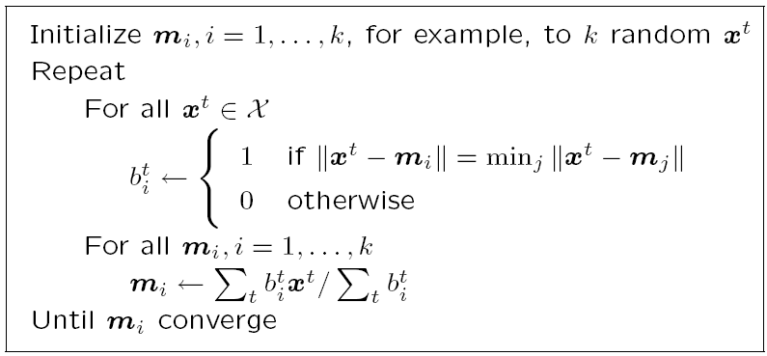

Slide 9
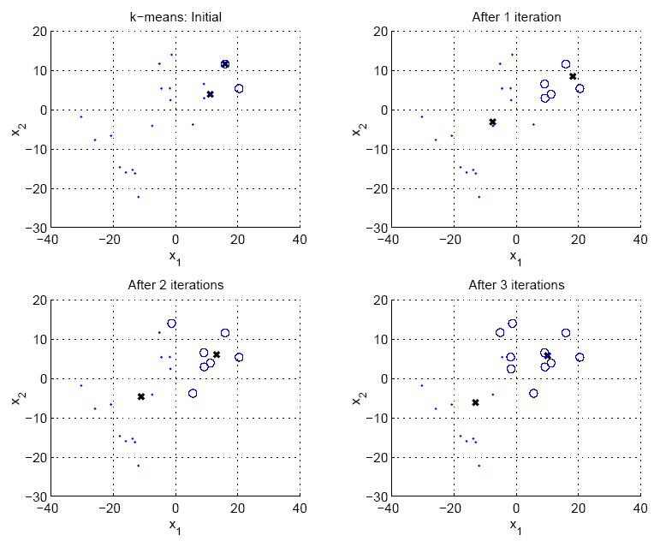

Slide 10
k-means only finds local minimum
The final m_{i} highly depend on the initial m_{i}
Initialization
  Randomly select k instances
  Random points drawn from a “reasonable" input space
  Add small random vectors to the mean of all instances
  Divide instances into k groups, and then take the means of these groups
  …

Slide 11
Agglomerative Clustering
Bottom-up strategy:
  Put every element into its own cluster
  Merge two most closest clusters
  If #cluster > 1, go to (2)
Distance measure between instances x^{r} and x^{s}
  Minkowski (L_{p}) (Euclidean for p = 2)
  City-block distance

Slide 12
Agglomerative Clustering
Distance between two groups G_{i} and G_{j}
  Single-link:
    Results in chaining
  Complete-link:
    Compact clusters
  Average-link:

Slide 13
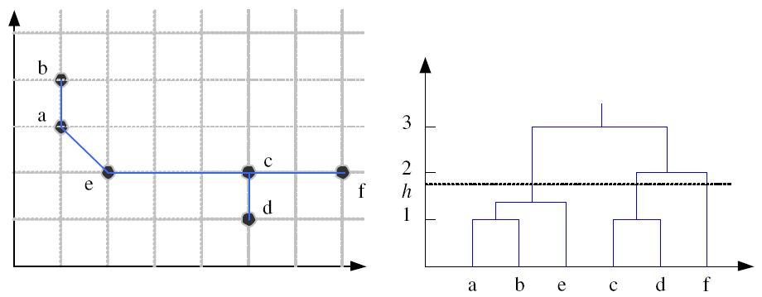
Example: Single-Link Clustering
Dendrogram

Slide 14
Choosing k
Defined by the application, e.g., image quantization
Plot data (after PCA) and check for clusters
Incremental (leader-cluster) algorithm: Add one at a time until “elbow” (reconstruction error/log likelihood/intergroup distances)
Manual check for meaning

